Slide 1


PRESENTATION ON
Telangana State Weather Data Analysis
Presented By:
Name : Yaddanapudi V S S Surya Teja
Batch : 456
Branch : DILSUKHNAGAR

Slide 2
About Me
My Name is Yaddanapudi V S S Surya Teja.
I have completed my Bachelor of Technology in Computer Science and Engineering.
LinkedIn : https://www.linkedin.com/in/suryateja-yaddanapudi/
GitHub : https://github.com/DudeAlpha007

Slide 3
Agenda
Introduction
Business Problem
Objectives
Data Overview
Report Overview
Key Insights
Conclusions
Recommendations

Slide 4
Introduction
Weather plays a vital role in shaping agriculture, water resources, public health, disaster management, and infrastructure planning.
Understanding long-term weather behavior requires analyzing large volumes of data across time, geography, and multiple climate parameters.
Telangana, with its diverse districts and climatic conditions, experiences significant variation in rainfall, temperature, humidity, and wind speed. Traditional analysis methods are insufficient to capture these patterns effectively.
This project leverages Power BI to transform historical weather data into interactive, visual, and actionable insights, enabling stakeholders to understand trends and support data-driven decision-making at district and mandal levels.

Slide 5

Business Problem
Weather conditions play a crucial role in agriculture, water management, disaster preparedness, public health, and infrastructure planning.
However:
Weather data is large, multi-dimensional, and spread across districts and mandals
Identifying seasonal trends, anomalies, and extreme conditions manually is difficult
Decision-makers lack visual, district-level insights for effective planning
Problem:
How can historical weather data of Telangana be transformed into clear, actionable insights to support data-driven decision-making?

Slide 6
Project Objectives
Analyze rainfall patterns across districts, mandals, seasons, and years
Study temperature trends and extremes at multiple geographic levels
Understand humidity variations and their seasonal behavior
Examine wind speed patterns and identify extreme wind events
Detected Extreme weather conditions
Build interactive Reports for easy exploration and comparison
Enabled district-to-district comparison for informed planning

Slide 7
Data Overview
Primary Dataset: Telangana State Weather Data
  Granularity
  District level
  Mandal level
  Daily observations
Data cleaned and transformed using Power Query Editor
Created a Date Table for time-based analysis: Year, Month, Quarter, Season, Day, Weekday.
Built a star schema : Weather (Fact table), Date Table (Dimension table).
Created DAX measure tables for: Rainfall, Temperature, Humidity, Wind Speed.
Key Weather Parameters: Rainfall (mm), Minimum & Maximum Temperature (°C), Minimum & Maximum Humidity (%), Minimum & Maximum Wind Speed (Kmph).

Slide 8
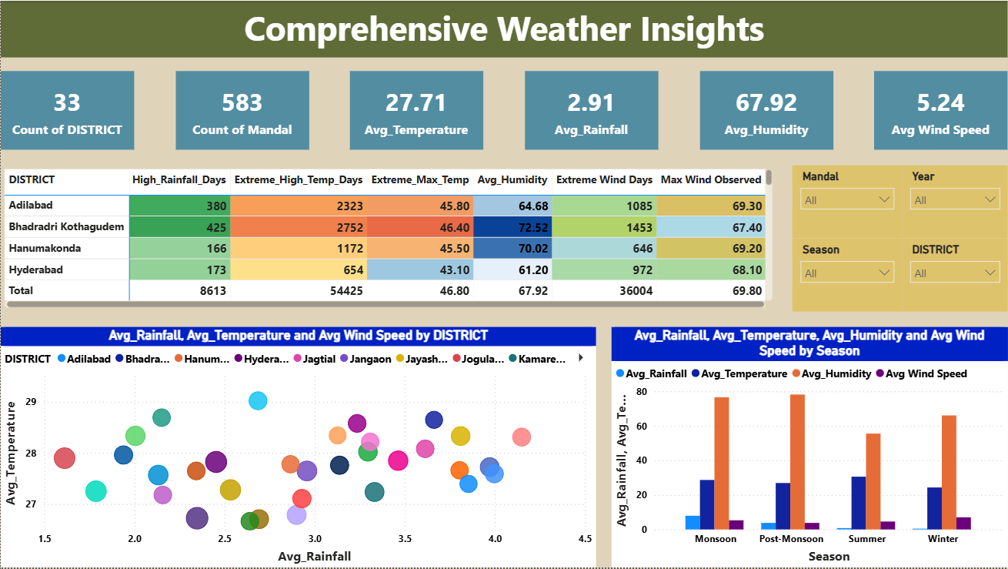

Slide 9
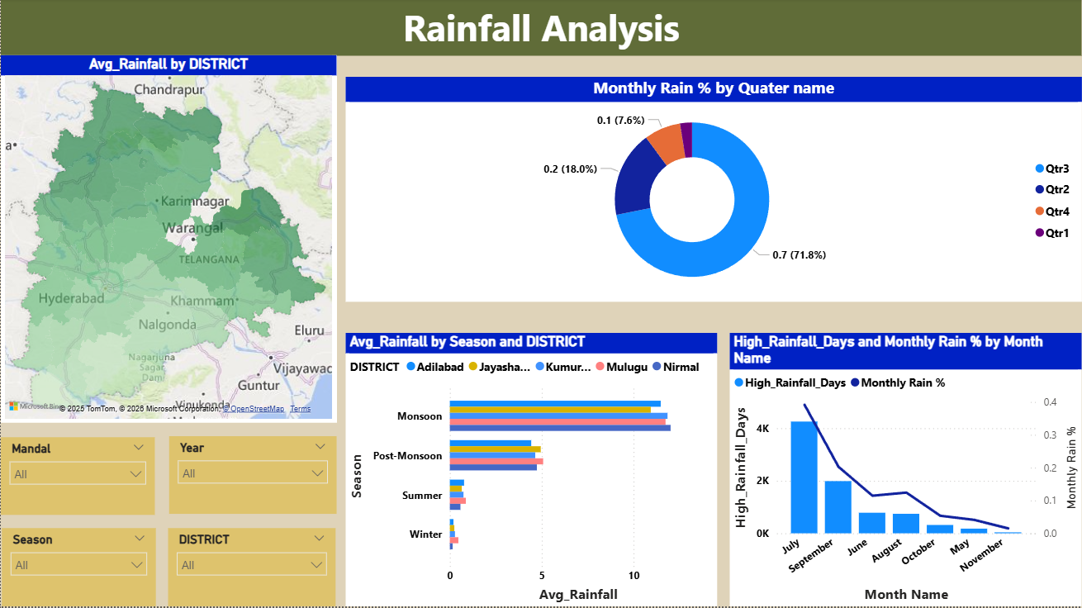

Slide 10
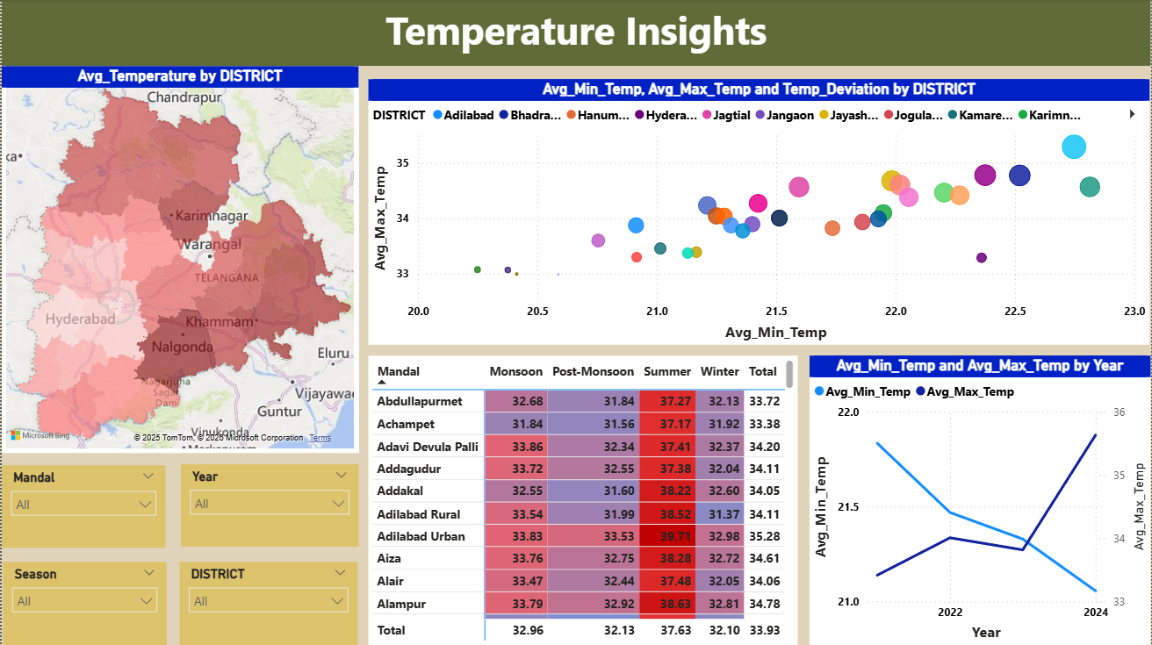

Slide 11
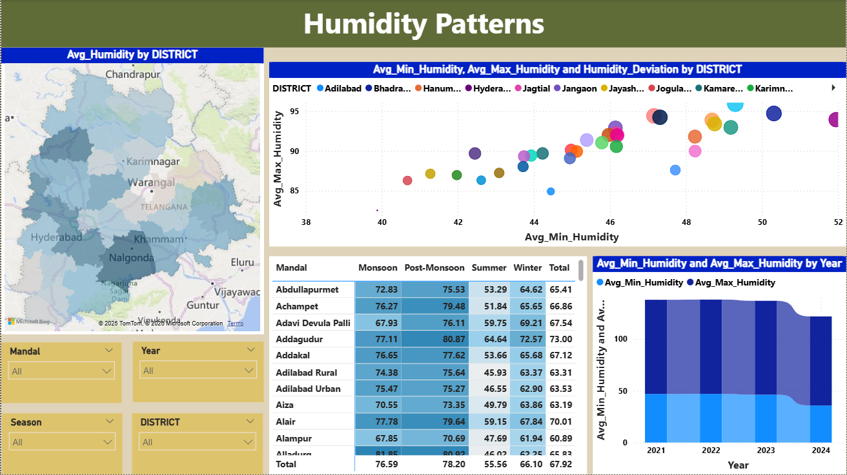

Slide 12
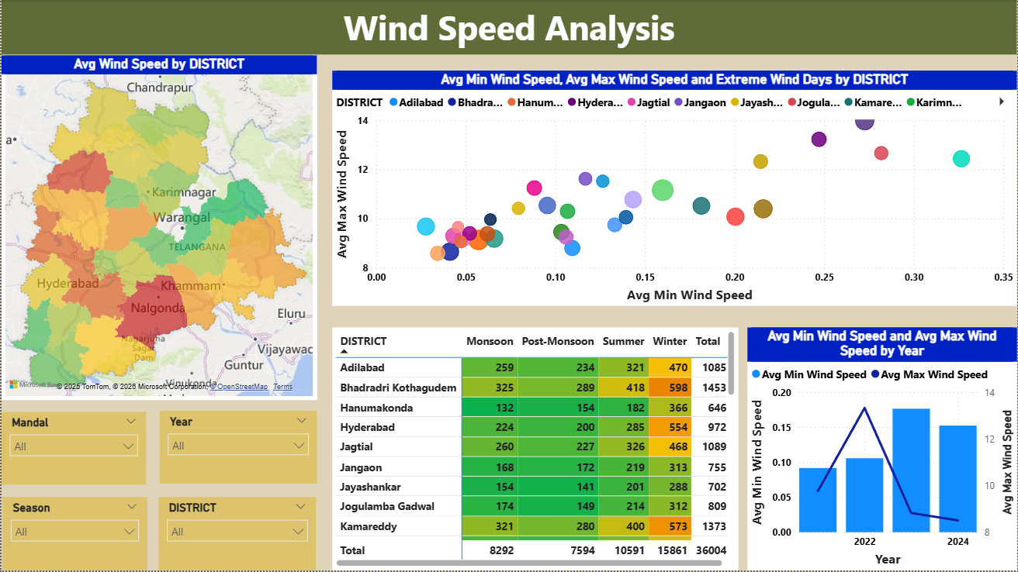

Slide 13
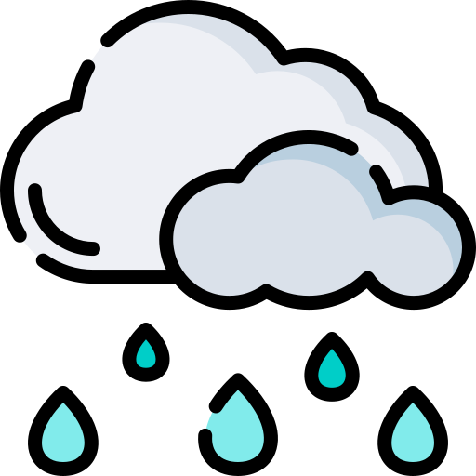
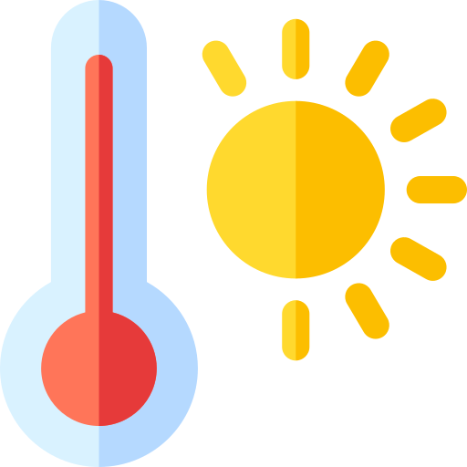


Key Insights
Rainfall Patterns
Over 80% of annual rainfall occurs during the monsoon season (June-September),
with July contributing ~39%.
Spatial disparity: Bhadradri Kothagudem receives ~425 mm/year, while Hyderabad averages ~63.7 mm.
Mandal-level rainfall variation exceeds 60% within districts.
Temperature Trends
A gradual warming trend is observed from 2021 to 2024, with average maximum temperatures increasing from 33.72°C to 33.93°C.
Summer months (April–June) experience extreme heat, with district averages reaching up to 46.8°C.
District extremes: Warangal records the highest temperatures; Adilabad experiences colder winter minimums.
Humidity Dynamics
Maximum humidity peaks at 96–100% during monsoon; minimum falls to ~80% in winter.
Coastal districts (e.g., Khammam, Nalgonda) have 15–20% higher humidity than inland areas.
Over 36,000 extreme humidity instances (100%) detected in 4 years.
Monsoon increases daily humidity range by 15–25%, affecting respiratory and comfort-related health.
Wind Speed Behavior
Peak speeds occur post-monsoon (Oct–Nov) at ~13.7 km/h, dropping to 8–10 km/h in summer.
Rangareddy records highest speeds (>14 km/h).
Bhadradri Kothagudem sees 1,453 extreme wind days, mainly post-monsoon.
~35% of days experience wind speeds >10 km/h, affecting agriculture, transport, and outdoor activities.

Slide 14
Conclusion
Strong Seasonal Consistency:
Weather patterns in Telangana show stable seasonal behavior over four years, with concentrated monsoon rainfall, summer heat peaks, humidity surges, and post-monsoon wind activity—supporting reliable season-based planning.
Clear Geographic Stratification:
Clear geographic disparities exist across the state. Western districts receive 3–4 times more rainfall, while coastal and eastern districts maintain 15–20% higher humidity levels year-round. Additionally, intra-district mandal variation exceeds 60%, indicating that district-level averages alone are insufficient for precise planning.
Rising Heat Risk:
A steady rise in average maximum temperature (0.05–0.07°C per year) is observed, with extreme summer temperatures reaching up to 46.80°C in certain districts. This highlights increasing heat stress risks and long-term climate vulnerability.
Interdependency of Weather Metrics:
Weather parameters do not operate in isolation. Clustering of high temperature, humidity, wind speed, and rainfall strongly influences public health, agriculture, and economic activity, reinforcing the need for multi-metric analysis rather than single-variable evaluation.

Slide 15
Recommendations
Agriculture & Water Management
Adopt district- and mandal-level planning based on rainfall seasonality. Prioritize monsoon water storage in high-rainfall districts and efficient irrigation and groundwater recharge in low-rainfall regions to improve crop resilience.
Public Health & Climate Risk Preparedness
Implement heat-stress early warning systems in high-risk districts and develop a humidity–health monitoring dashboard to predict and mitigate respiratory and heat-related illnesses during high-temperature and high-humidity periods, especially in monsoon months.
Infrastructure & Transport Resilience
Strengthen weather- and wind-resilient infrastructure standards in districts prone to extreme post-monsoon winds, and align transport planning with seasonal weather patterns to reduce disruptions.
Real-Time Monitoring & Decision Support
Expand mandal-level weather monitoring and integrate real-time analytics and alerts using Power BI to support proactive disaster management and policy decisions.

Slide 16


Slide 17


